Slide 1
CSE 474
Pattern Recognition Sessional
Lab# 1: Implementation of a Naïve Bayes Classifier

Slide 2
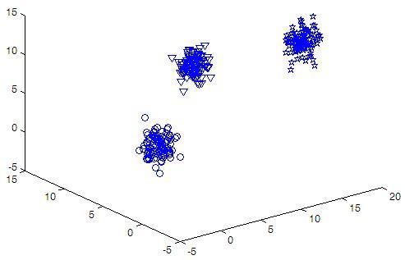
Naïve Bayes Classifier
Assume following training set is given
  3 classes
  3 features

Slide 3
Naïve Bayes Classifier
Assume following training set is given
  All numerical data
  Assume features are
  conditionally independent
  given class information
F1 F2 F2 Class
9.4512 7.3199 6.4664 1
10.7276 9.6067 5.9398 3
10.1960 9.3145 8.3873 1
15.7777 1.5879 11.4440 2
15.8685 2.7902 11.2532 3
14.9448 0.7798 12.7481 2

Slide 4
Naïve Bayes Classifier
Given an unknown sample,
[F1, F2, F3] = [10.1960 9.3145 8.3873]
Predict its class!

Slide 5
Naïve Bayes Classifier
Given an unknown sample,
[F1, F2, F3] = [10.1960 9.3145 8.3873]
Predict its class!
Calculate posterior probabilities for each class C_{i}
P(C_{i}| F1,F2,F3) ~ = P(C_{i}) P(F1|C_{i}) P(F2|C_{i}) P(F3|C_{i})

Slide 6
Naïve Bayes Classifier
Given an unknown sample,
[F1, F2, F3] = [10.1960 9.3145 8.3873]
Predict its class!
Calculate posterior probabilities for each class C_{i}
P(C_{i}| F1,F2,F3) ~ = P(C_{i}) P(F1|C_{i}) P(F2|C_{i}) P(F3|C_{i})
Assign [F1, F2, F3] to C_{i} if P(C_{i}| F1,F2,F3)> P(C_{j}| F1,F2,F3) for all j

Slide 7
Naïve Bayes Classifier
To estimate P(F_{j}|C_{i}) assume each F_{j} follows Gaussian distribution
F1 F2 F2 Class
9.4512 7.3199 6.4664 1
10.7276 9.6067 5.9398 3
10.1960 9.3145 8.3873 1
15.7777 1.5879 11.4440 2
15.8685 2.7902 11.2532 3
14.9448 0.7798 12.7481 2

Slide 8
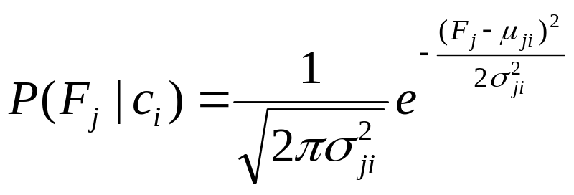
Naïve Bayes Classifier
To estimate P(F_{j}|C_{i}) assume each F_{j} follows Gaussian distribution
  For each class/feature pair, find Gaussian parameters (mean and standard deviation of features)
  Use following formula to get P(F_{j}|C_{i})

Slide 9
Naïve Bayes Classifier
Priors, P(C_{i}), can be easily estimated by counting the no. of training samples of the corresponding classes

Slide 10
Naïve Bayes Classifier
Priors, P(C_{i}), can be easily estimated by counting the no. of training samples of the corresponding classes
Use all P(F_{j}|C_{i})’s and P(C_{i}) to calculate
P(C_{i}| F1,F2,F3) ~ = P(C_{i}) P(F1|C_{i}) P(F2|C_{i}) P(F3|C_{i})

Slide 11
Naïve Bayes Classifier
Training File: train.txt
  Use this file for training (estimating the Gaussian parameters and priors)
  File format:
    first line contains 3 integers m n p. m= no. of features, n= no. of classes, p=no. of samples
    Each of next p lines contains m feature values followed by its class in integer

Slide 12
Naïve Bayes Classifier
Testing file: test.txt
  Use this file for calculating % of accuracy
  Format is identical but the first line is removed

Slide 13
Naïve Bayes Classifier
Output:
  Identify all misclassified samples and report as follows
  sample no. feature values actual class estimated class
  % of accuracy

